Slide 1
Discrete Mathematics
South China University of Technology
1

Slide 2
Chapter 3. Algorithms, Division and Matrix
The Growth of Functions
Section 3.2

Slide 3
Contents
1
Introduction
2
Big-O
3
Big-Theta

Slide 4
Introduction

Slide 5
Orders of Growth - Motivation
Suppose you are designing a web site to process user data (e.g., financial records).
Suppose database program A takes f_{A}(n)=30n+8 microseconds to process any n records, while program B takes f_{B}(n)=n²+1 microseconds to process the n records.
Which program do you choose, knowing you’ll want to support millions of users?
A

Slide 6
Visualizing Orders of Growth
On a graph, as
you go to the
right, the faster-
growing func-
tion always
eventually
becomes the
larger one...
f_{A}(n)=30n+8
Value of function →
f_{B}(n)=n²+1
Increasing n →

Slide 7
Concept of order of growth
We say f_{A}(n)=30n+8 is (at most) order n, or O(n).
  It is, at most, roughly proportional to n.
f_{B}(n)=n²+1 is order n², or O(n²).
  It is (at most) roughly proportional to n².
Any function whose exact (tightest) order is O(n²) is faster-growing than any O(n) function.
  Later we will introduce Θ for expressing exact order.
For large numbers of user records, the exactly order n² function will always take more time.

Slide 8
Big-O Notation

Slide 9
Definition: O(g)
Let f, g be any function Z⁺→R⁺. We say that f (x) is O(g(x)), if
∃c ∈ R⁺ ∃ k ∈ Z⁺ ∀x>k: f (x) ≤ cg(x)
whenever x > k.
f⪯g
f=O(g)
f∈O(g)
f is at most order g
f is O(g)

Slide 10
“Big-O” Proof Examples
Show that 30n+8 is O(n).
Proof:
  Show ∃c,k: ∀n>k: 30n+8 ≤ cn.
  Let c=31, k=8. Assume n>k=8.
  Then
  cn = 31n = 30n + n > 30n+8,
  so 30n+8 < cn.

Slide 11
“Big-O” Proof Examples
Show that n²+1 is O(n²).
Proof
  Show ∃c,k: ∀n>k: n²+1 ≤ cn².
  Let c=2, k=1.
  Then
  cn² = 2n² = n²+n² > n²+1, or n²+1< cn².

Slide 12
Points about the definition
Note that the particular c, k, values are not unique.
You are not required to find the smallest c and k values that work. (Indeed, in some cases, there may be no smallest values!)
However, you should prove that the values you choose do work.

Slide 13
Big-O example, graphically
Note 30n+8 isn’t
less than n
anywhere (n>0).
It isn’t even
less than 31n
everywhere.
But it is less than
31n everywhere to
the right of n=8.
cn =
31n
30n+8
30n+8
∈O(n)
Value of function →
n
n>k=8 →
Increasing n →

Slide 14
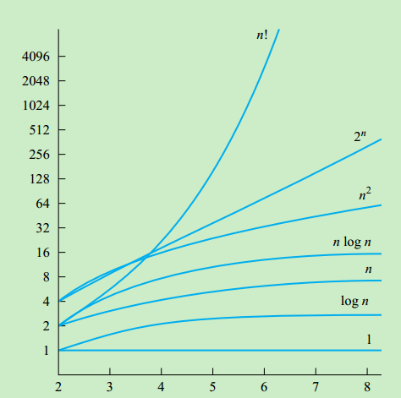
A Display of the Growth of Functions Commonly Used in Big-O Estimates

Slide 15
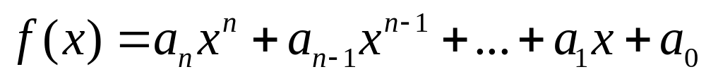
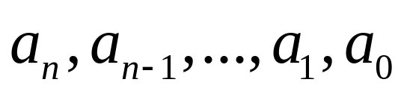
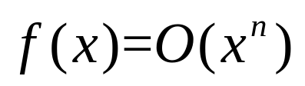
Case
Let ,
are real number. Then .

Slide 16
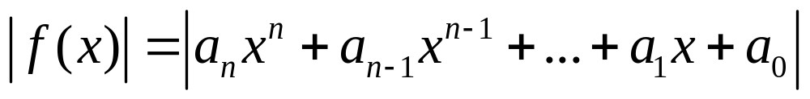
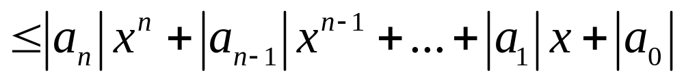
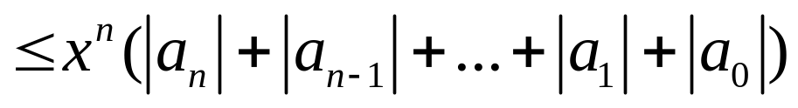

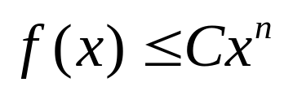
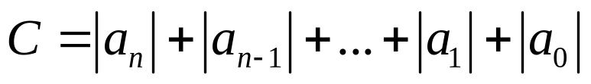

Case
Proof:

Slide 17
Orders of Growth - So Far
O(g) ≡ {f:R→R | ∃c,k ∀x>k |f(x)| ≤ |cg(x)|}.
  Often, one deals only with positive functions and can ignore absolute value symbols.
f⪯g
f=O(g)
f∈O(g)
f is at most order g
f is O(g)

Slide 18
Order-of-Growth Expressions
Example: “x²+O(x)”
means “x² plus some function that is O(x)”.
Formally, x²+O(x) :≡ {x²+f(x) | f∈O(x)}

Slide 19
Order of Growth Equations
Suppose S and T are order-of-growth expressions. Then S=T really means
  ∀f∈S, ∃g∈T : f=g
  or simply S⊆T.
Example: x² + O(x) = O(x²) means
∀f∈O(x): ∃g∈O(x²): x²+f(x)=g(x)

Slide 20
Useful Facts about Big O
Big O, as a relation, is transitive:
  f=O(g) ∧ g=O(h) ⇒ f=O(h)
  or f ⪯ g ∧ g ⪯ h ⇒ f ⪯ h
Sums of functions:
  g=O(f) ∧ h=O(f) ⇒ g+h=O(f)
  or g ⪯ f ∧ h ⪯ f ⇒ g+h ⪯ f.

Slide 21
More Big-O facts
∀c>0, O(cf)=O(f+c)=O(f−c)=O(f)
f₁=O(g₁) ∧ f₂=O(g₂) ⇒
  f₁ f₂ ∈O(g₁g₂)
  f₁+f₂ ∈O(g₁+g₂)
  = O(max(g₁,g₂))

Slide 22
Big-Omega
Notation

Slide 23
Definition: f= Ω(g)
Let f, g be any function Z⁺→R⁺. We say that f=Ω(g) , if
∃c ∈ R⁺ ∃ k ∈ Z⁺∀x>k: f (x) ≥ cg(x)
whenever x > k.
  f⪰ g
  f∈ Ω(g)
  f=Ω(g)
Example: 8x³ + 5x² + 7 = Ω(x³)

Slide 24
Definition: f= Ω(g)
f=Ω(g) ⇔ g=O(f)
f⪰g ⇔ g ⪯ f
启示: 下界的证明, 可以转化为上届的证明
Example, 证明f=Ω(g) , 可以转为证明 g=O(f) , 2者等价, 后者更为我们熟悉.

Slide 25
Big-Theta Notation

Slide 26
Definition: f=Θ(g)
Let f, g: Z⁺→R⁺. we define f=Θ(g) (or f ~g) as follows.
  Version 1: f=Θ(g), if f = O(g) and f = Ω(g), ie, g ⪯ f ⪯ g.
  Version 2: f=Θ(g), if
∃c_{1,}c_{2,}k>0 ∀x>k: c₁g(x)≤f(x)≤c₂g(x)
we say “g and f are of the same order” or “f is (exactly) order g”

Slide 27
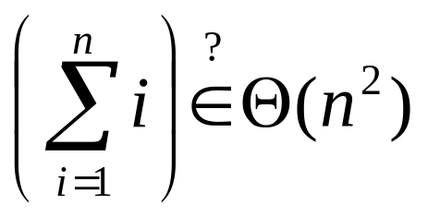
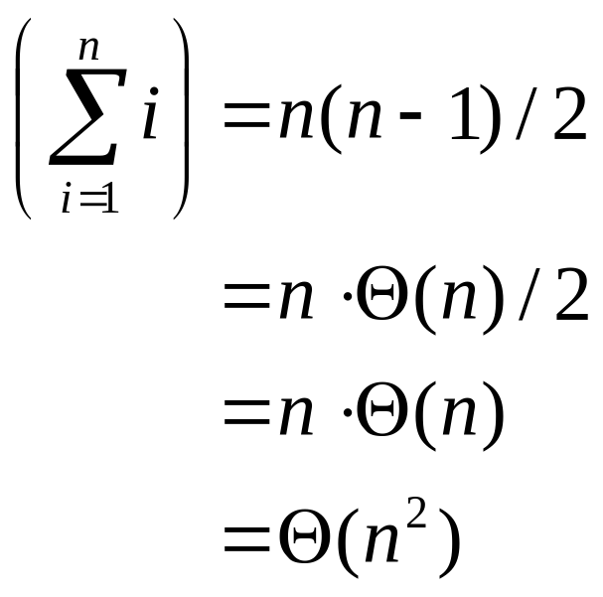
Θ example
Determine whether:
Quick solution:

Slide 28
Rules for Θ
∀ f,g>0 & constants a,b∈R, with b>0,
af ∈ Θ(f), but ← Same as with O.
f ∉ Θ(fg) unless g=Θ(1) ← Unlike O.
|f| ^{1-b} ∉ Θ(f), and ← Unlike with O.
(log_{b} |f|)ª ∉ Θ(f). ← Unlike with O.

Slide 29


Strict Ordering of Functions
Temporarily let’s write
to mean f∈o(g),

Slide 30
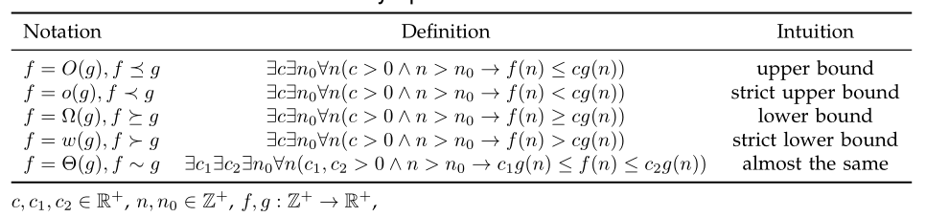
Other Order-of-Growth Relations
重点掌握: O, Ω, Θ,
强调: 上述各种界限的证明, 都可以转换为上界的证明.

Slide 31

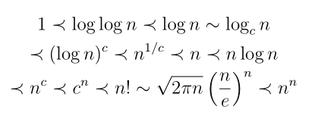
Strict Ordering of Functions
The figure shows
Let c> 1, it is proven that

Slide 32
Relations Between the Relations
Subset relations between order-of-growth sets.
R→R
O( f )
Ω( f )
• f
o( f )
Θ( f )
ω( f )

Slide 33
Why o(f)⊂O(x)−Θ(x)
A function that is O(x), but neither o(x) nor Θ(x):

Slide 34
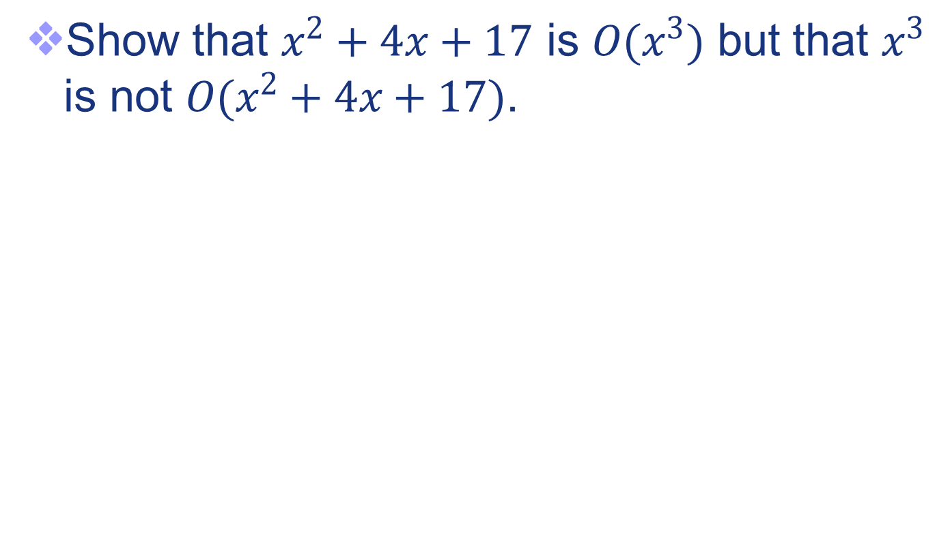
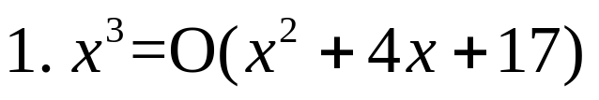
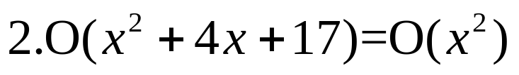
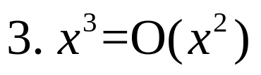


历史上的考题

Slide 35
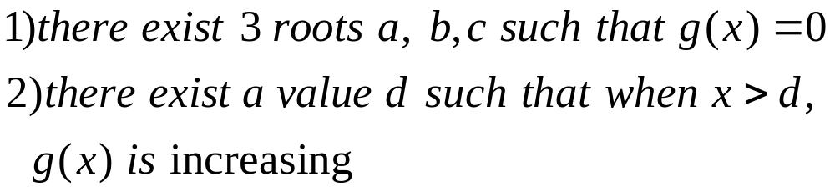
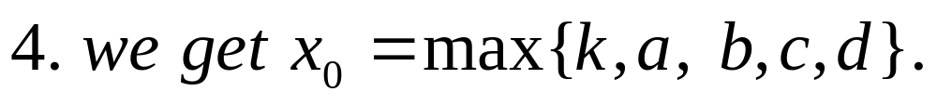
历史上的考题

Slide 36
End of Section 3.2
Click to edit company slogan .

